Slide 1
Word Association Norms, Mutual Information and Lexicography

Slide 2
Plan
Summarize main points of paper
Call out
some highlights of subsequent literature
suggestions for future work

Slide 3
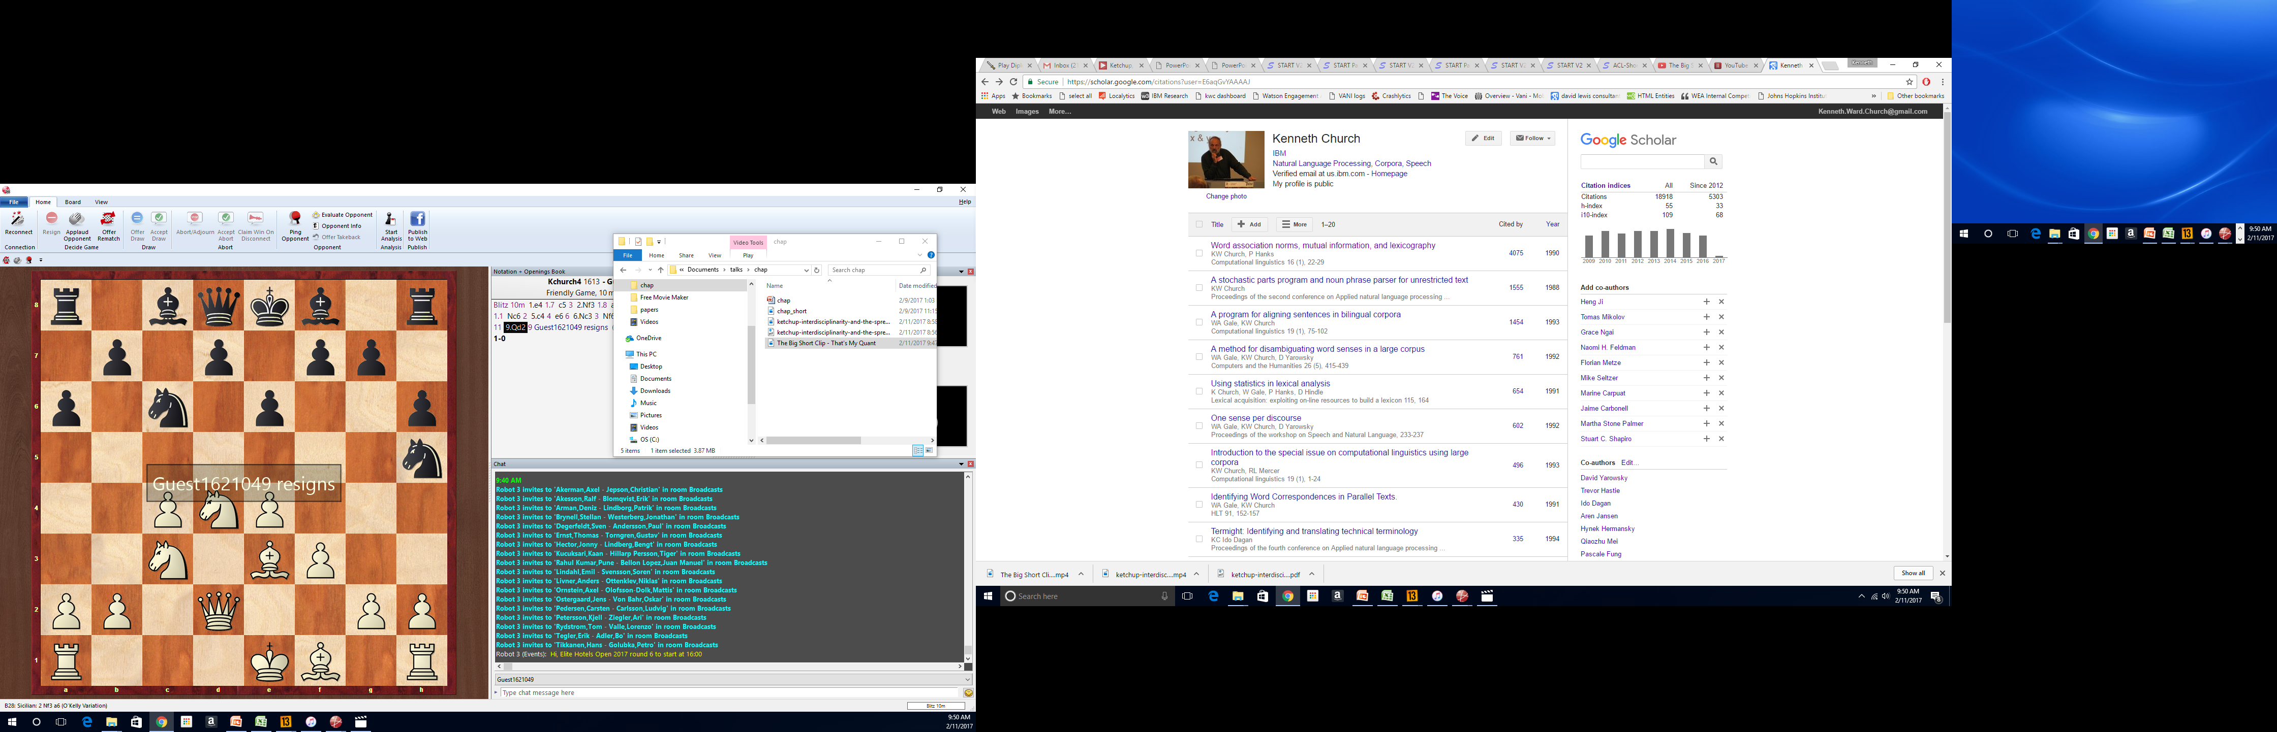
A Big Tent
My more successful papers don't tend to invent new ideas,
but rather borrow ideas from established fields and
connect the dots to novel applications in other fields
I love to work with smart colleagues that know neat stuff
that’s fun to hear about
Interdisciplinary team
Gale (Statistics)
Hanks (Lexicography)
Hindle (Linguistics)

Slide 4
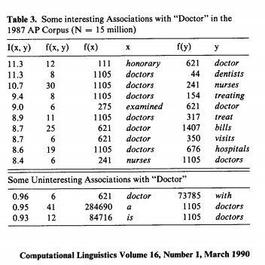
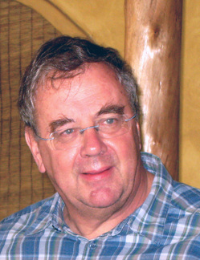

Slide 5
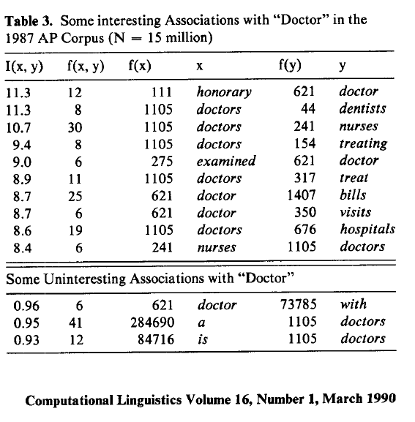
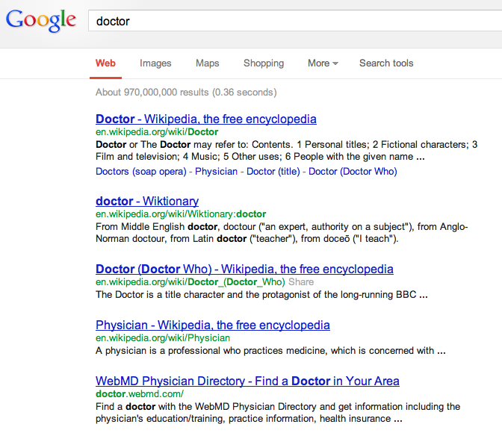
There is no data like more data
Counts are growing 1000x per decade
(same as disks)
Counts are growing 1000x per decade
(same as disks)
Rising Tide of Data Lifts All Boats

Slide 6
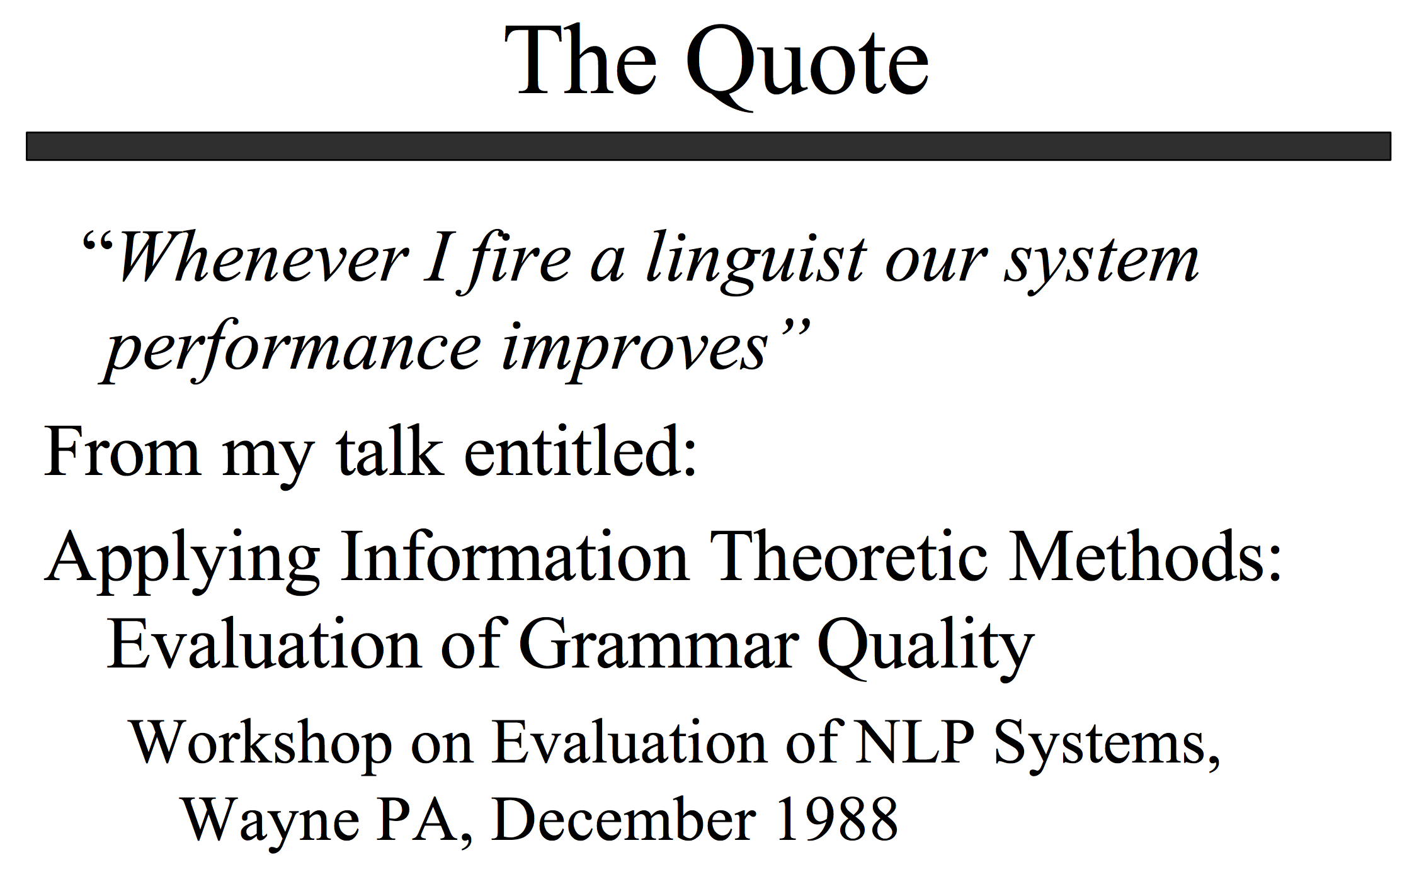
http://www.lrec-conf.org/lrec2004/doc/jelinek.pdf

Slide 7


Slide 8
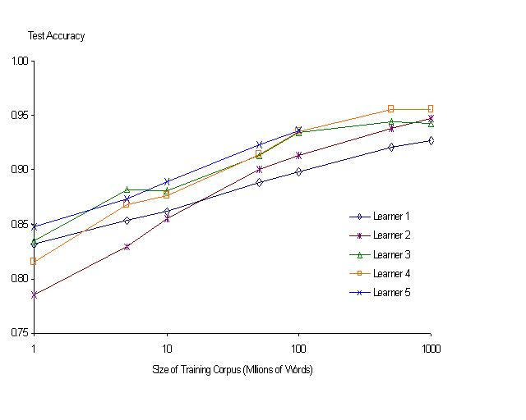
“It never pays to think until you’ve run out of data” – Eric Brill
Moore’s Law Constant:
Data Collection Rates → Improvement Rates
Banko & Brill: Mitigating the Paucity-of-Data Problem (HLT 2001)
No consistently
best learner
There is no data like more data
Quoted out of context
Fire everybody and
spend the money on data

Slide 9
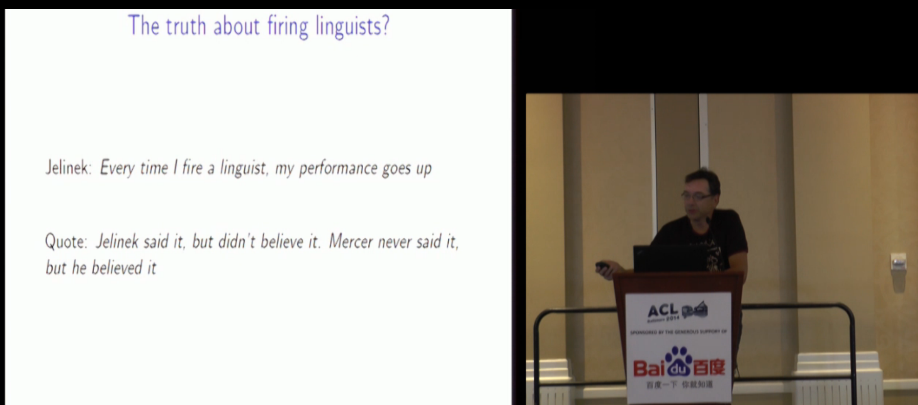
Robert Mercer ACL Lifetime Achievement http://techtalks.tv/talks/closing-session/60532/

Slide 10
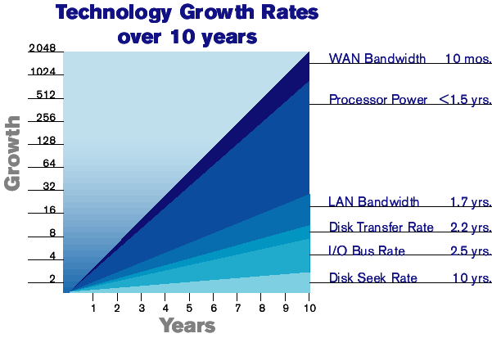

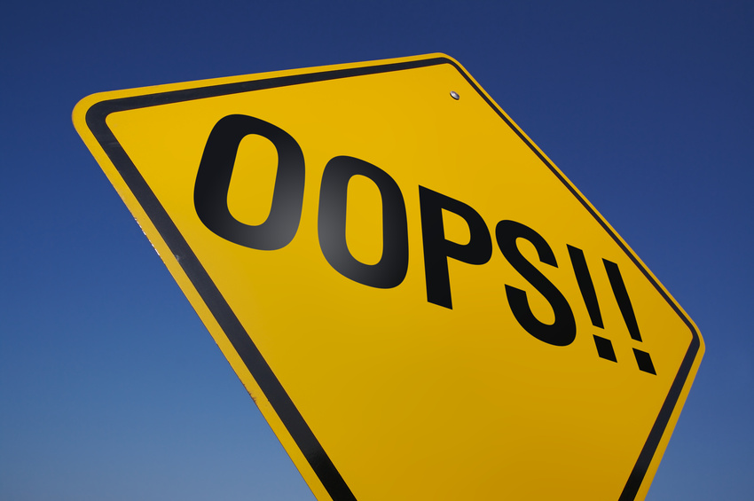
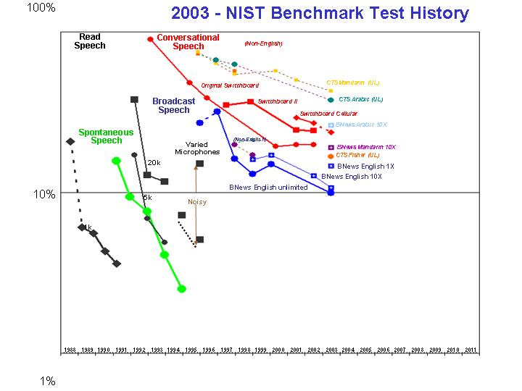
The Disk Space Conjecture
Improvements in Speech, Language (& more)
are indexed to improvements in disk capacities
because disk prices → size of web → training data
2003 Prediction:
Disks improve1000x per decade
1TB: $1k (2003) → $1 (2013)
Missed by 30x (a TB is currently ~ $30 >> $1)

Slide 11
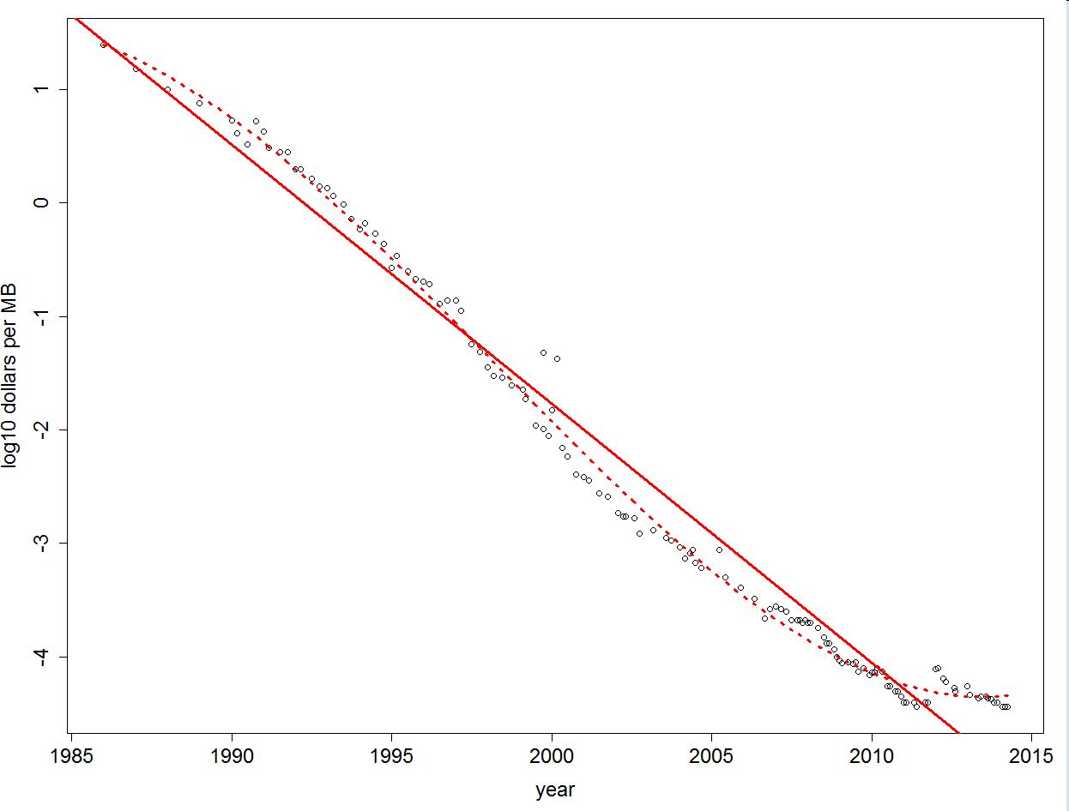
Disk Prices Over 30 Years http://www.jcmit.com/diskprice.htm
191x cheaper per decade (1985-2014)
1750x cheaper per decade (1995-2003)
Flood

Slide 12
Moore’s Law: Different Time Constants for Different Things https://archive.is/3pgVP

Slide 13
Word Association Norms: Doctor / Nurse
Counts are growing 1000x per decade
(same as disks)
Counts are growing 1000x per decade
(same as disks)
Rising Tide of Data Lifts All Boats

Slide 14
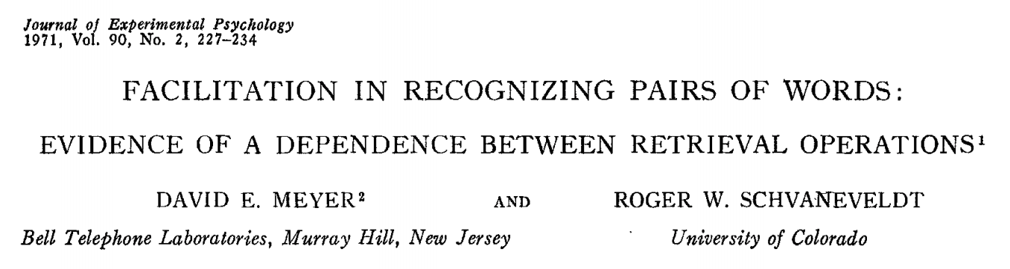
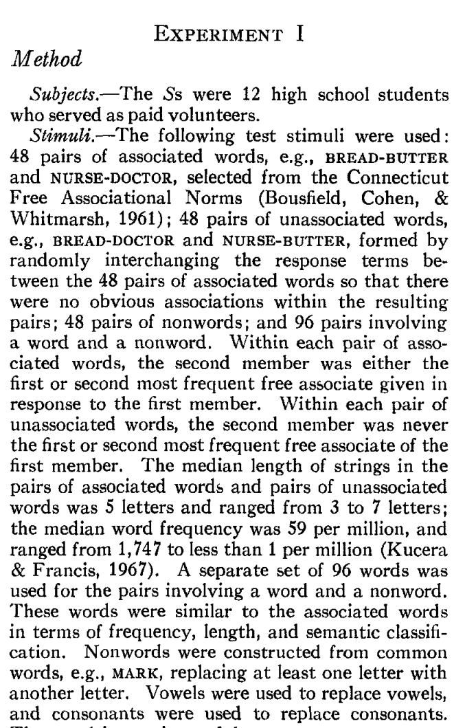
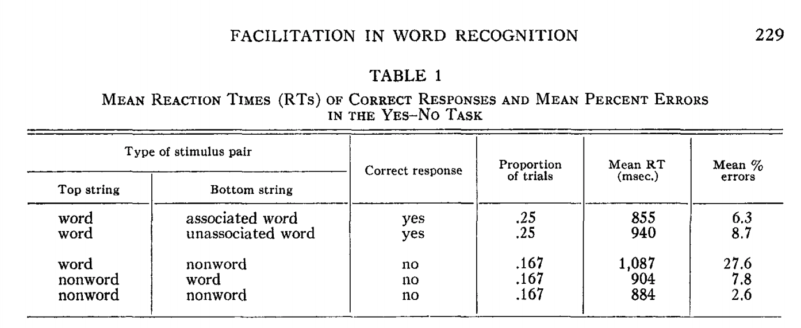
Priming & Word Associations Task: Subject is given two strings and responds “yes” if both are words

Slide 15
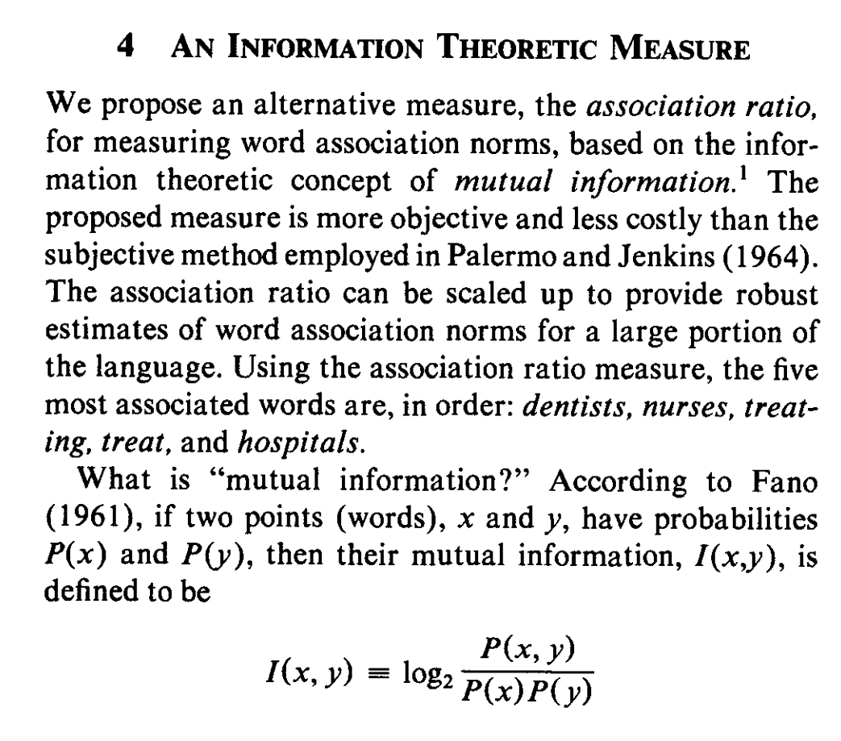
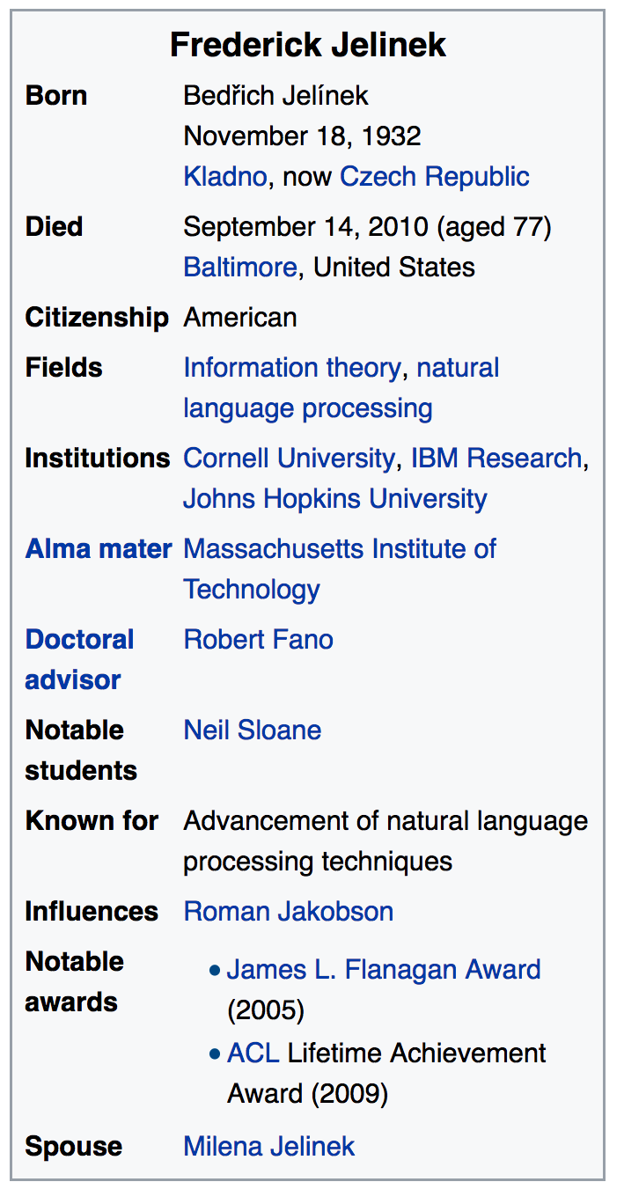
Pointwise Mutual Information (PMI)
Simple interpretation
PMI compares P(x,y) with chance
Chance = P(x) P(y)
If there is a genuine association
then P(x,y) >> P(x) P(y)
Uninteresting associations
P(x,y) ≈ P(x) P(y)
Popular applications (lexicography)
more like hypothesis testing
focus on largest PMI
where we can reject null hypothesis
null hypo: uninteresting
less like language modeling for speech and machine translation

Slide 16
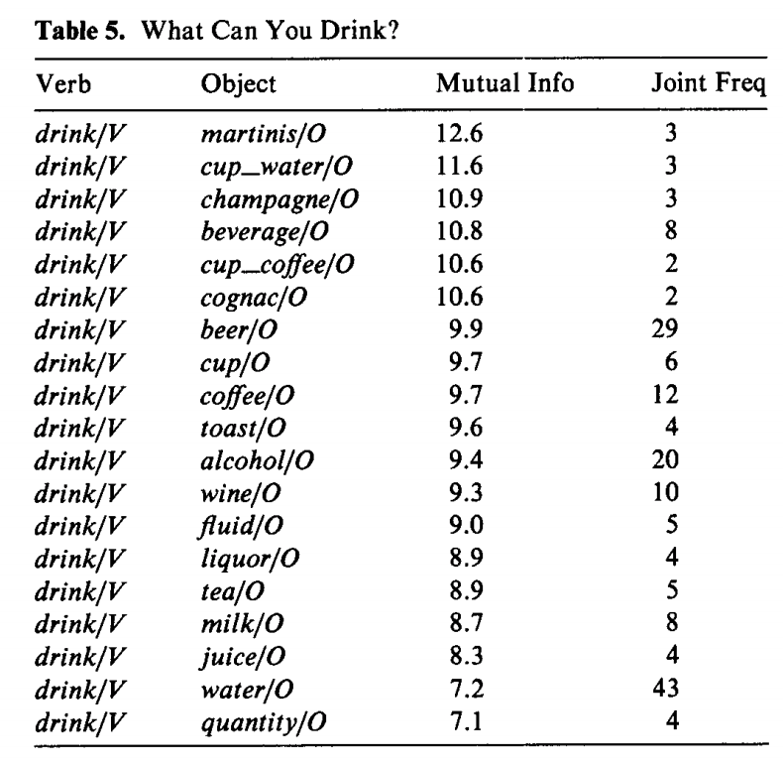
Windows for computing P(x,y)
Bigrams:
rectangular window with width of 1 word
Ngrams
rectangular window with width of n-1 words
More generally
Windows need not be rectangular
Or symmetric around 0
(Mutual Information is symmetric
but “Association Measure” is not)
Convenient to assume windows sum to 1
More interesting windows
Parse Trees / SVO

Slide 17
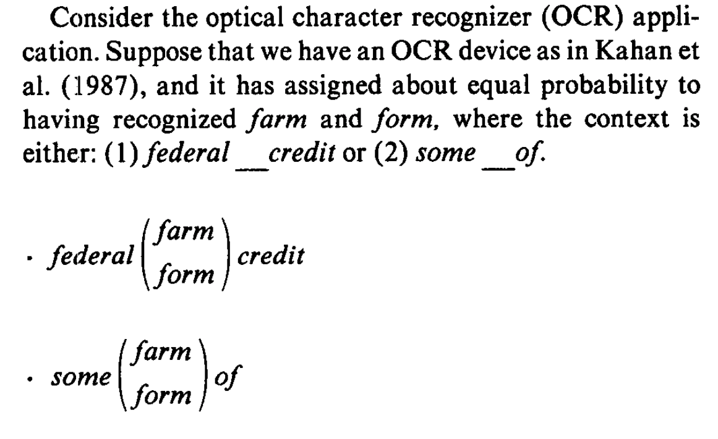
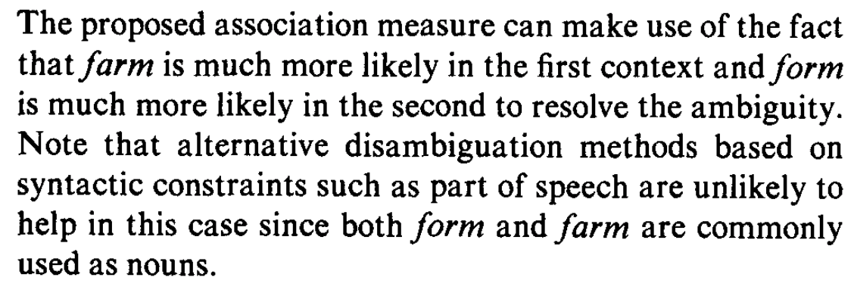
OCR Application

Slide 18
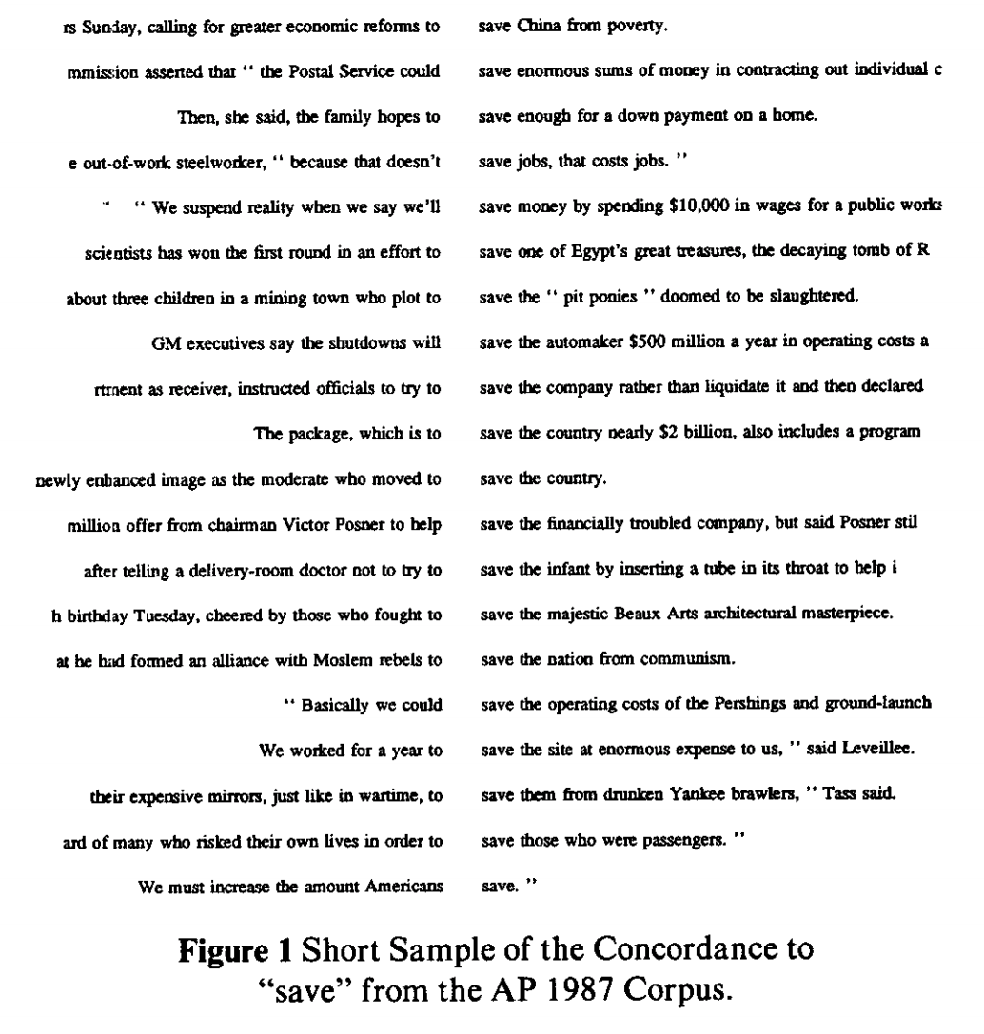
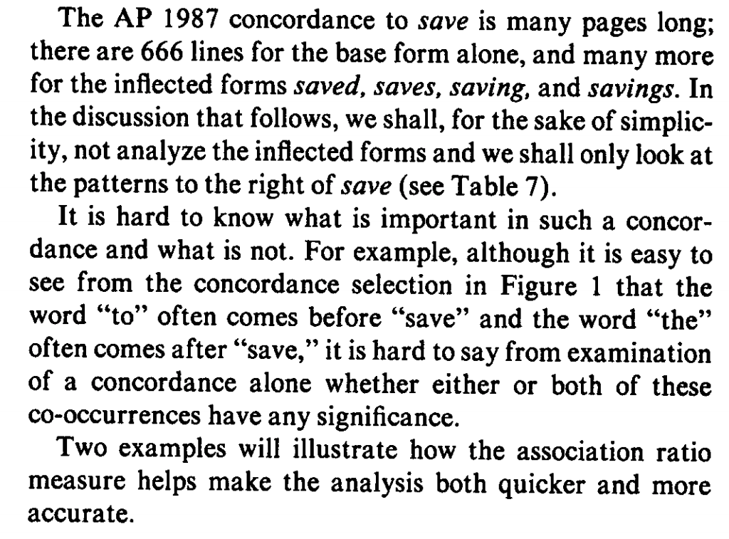
Applications in Lexicography

Slide 19
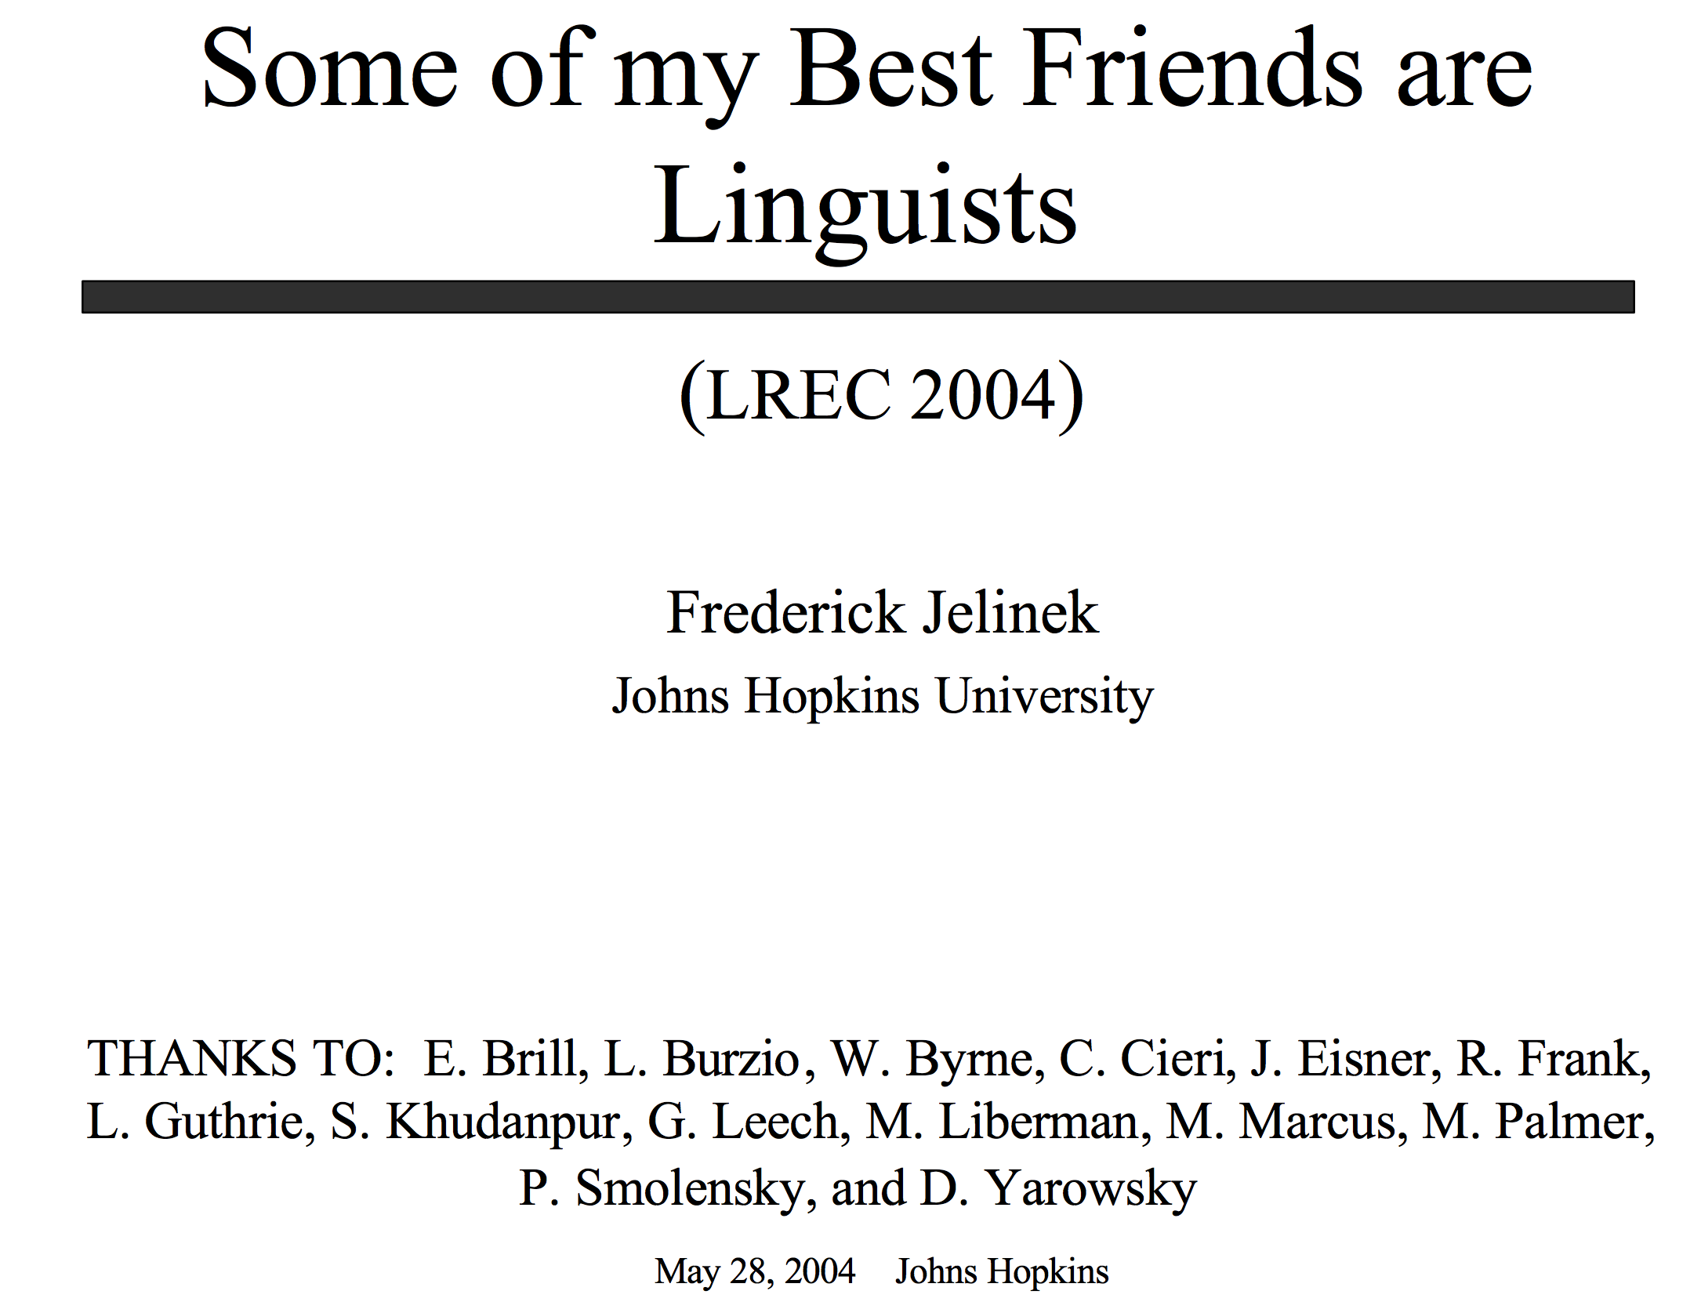
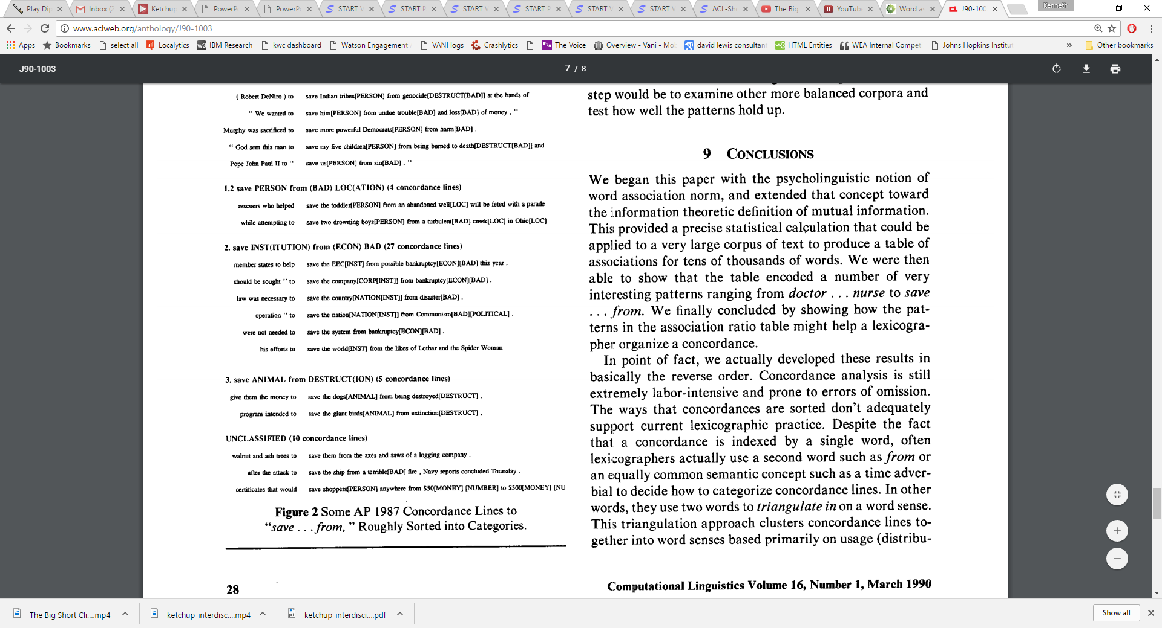
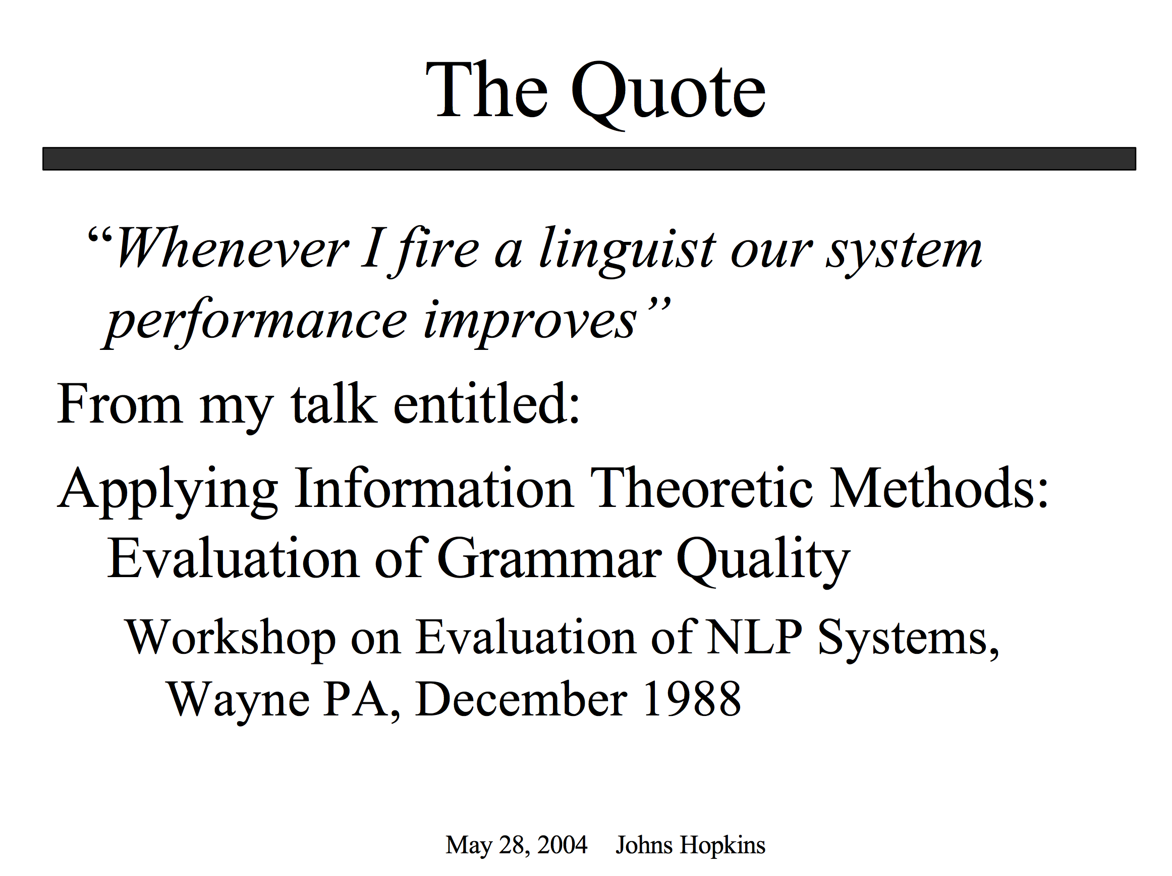
Proper Place for Automation: Start with Drudgery (Support our colleagues; don’t talk too much about taking away jobs they love to do)

Slide 20
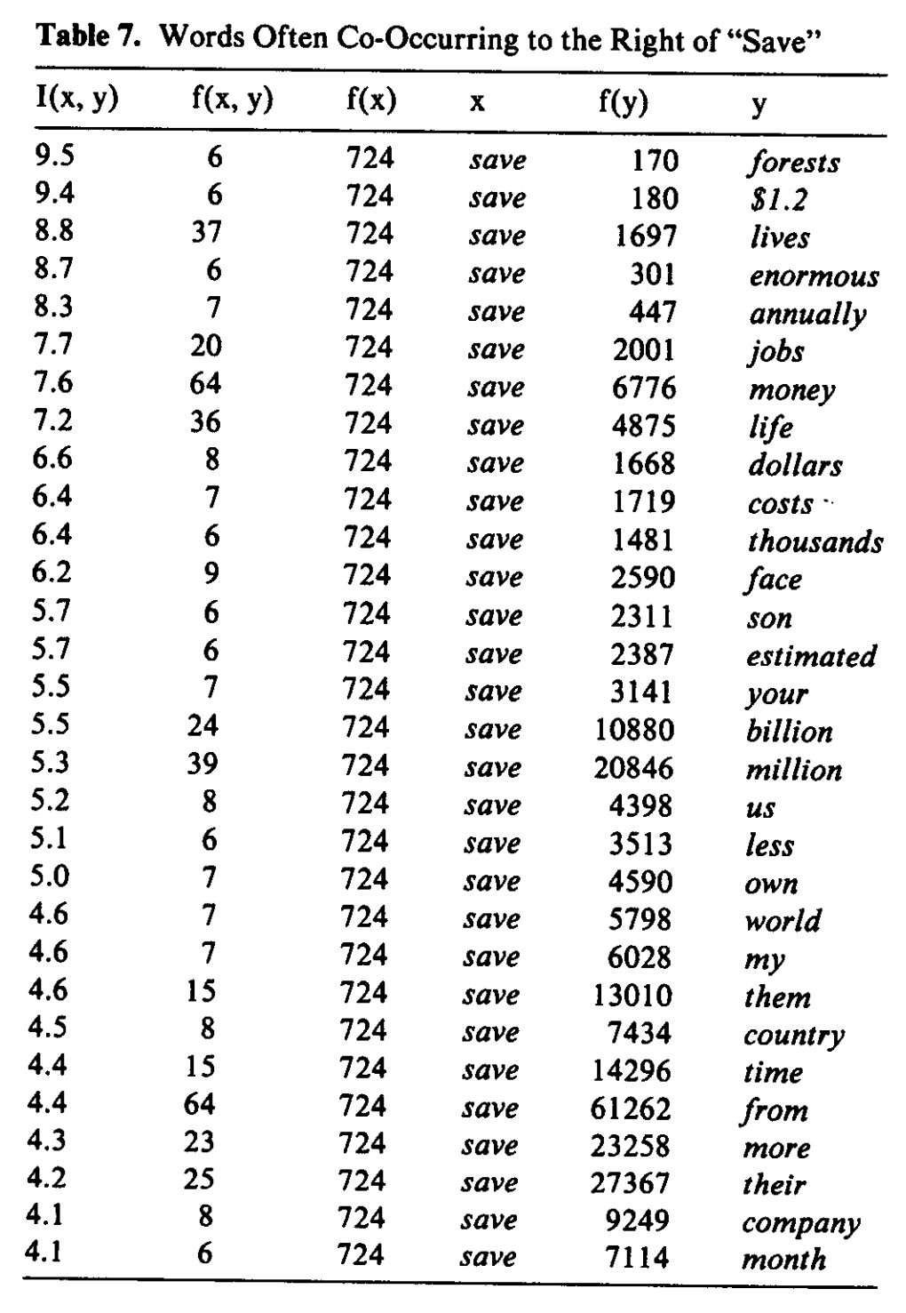
Patrick found tables like this very exciting

Slide 21
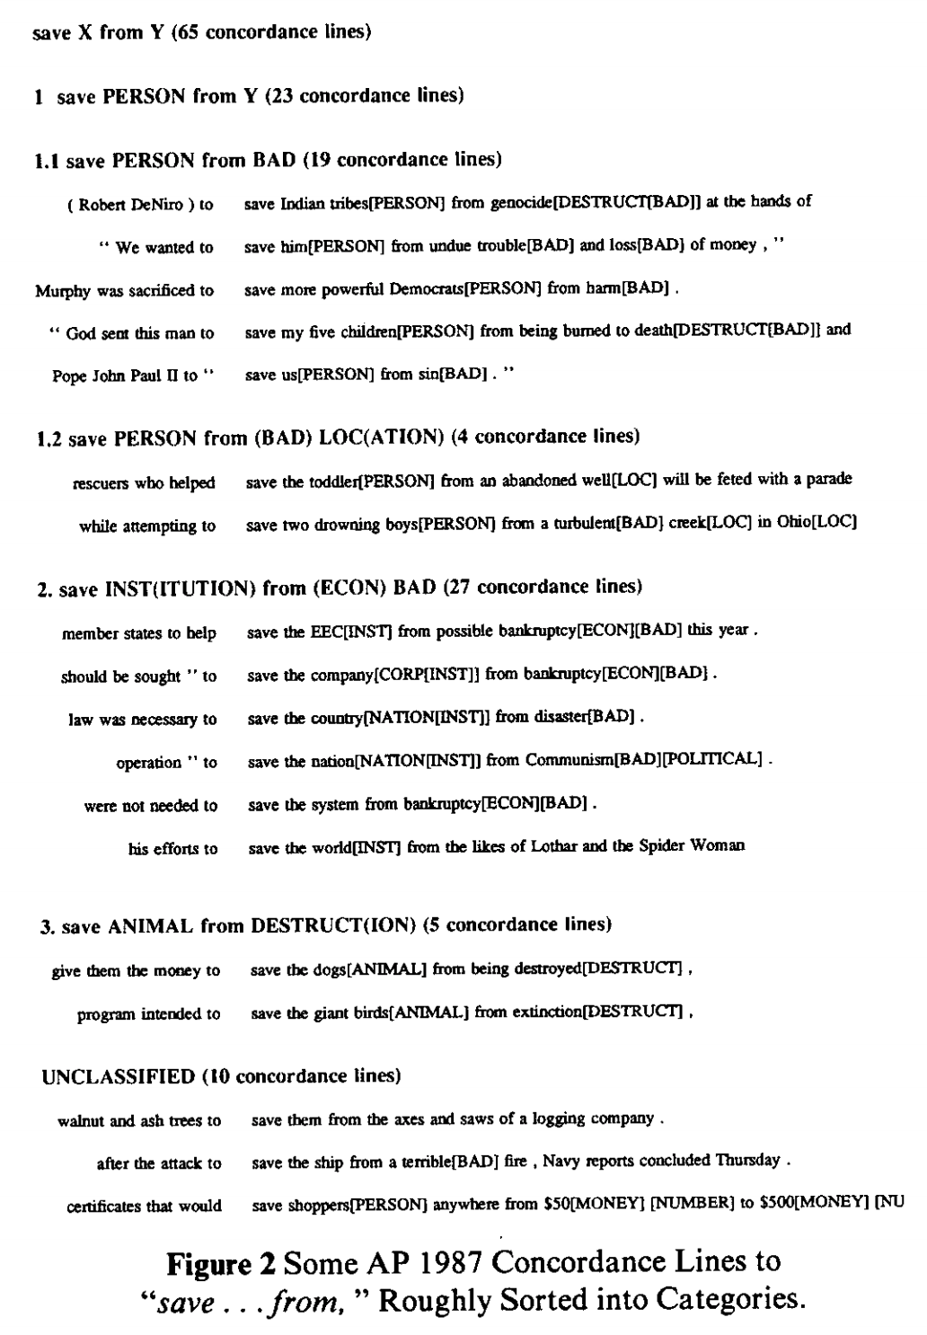
Save <good> from <bad>

Slide 22
Save good shoppers from their evil $$
Patrick wanted me to “fix” my bug

Slide 23
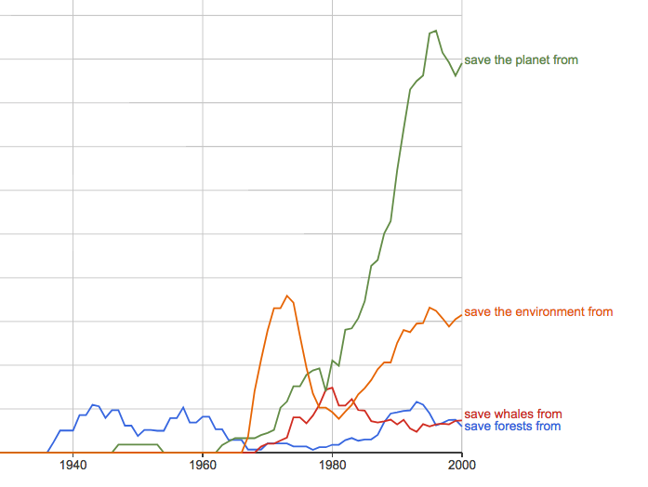
https://books.google.com/ngrams/graph?content=save+forests+from%2Csave+whales+from%2Csave+the+planet+from%2Csave+the+environment+from&year_start=1800&year_end=2000&corpus=15&smoothing=3&share=&direct_url=t1%3B%2Csave%20forests%20from%3B%2Cc0%3B.t1%3B%2Csave%20whales%20from%3B%2Cc0%3B.t1%3B%2Csave%20the%20planet%20from%3B%2Cc0%3B.t1%3B%2Csave%20the%20environment%20from%3B%2Cc0
Google Ngrams

Slide 24
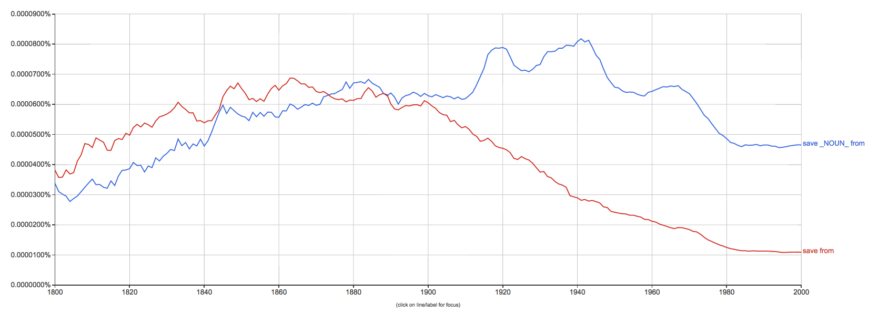
save from ≠ save X from Y

Slide 25
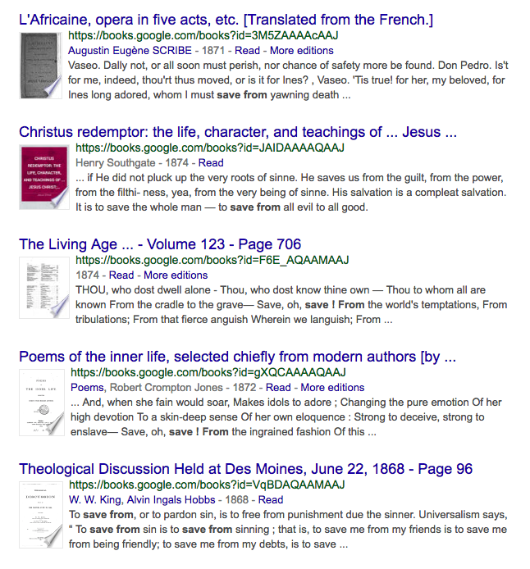
save from ≠ save X from Y

Slide 27
Plan
Summarize main points of paper
Call out
some highlights of subsequent literature
suggestions for future work

Slide 28
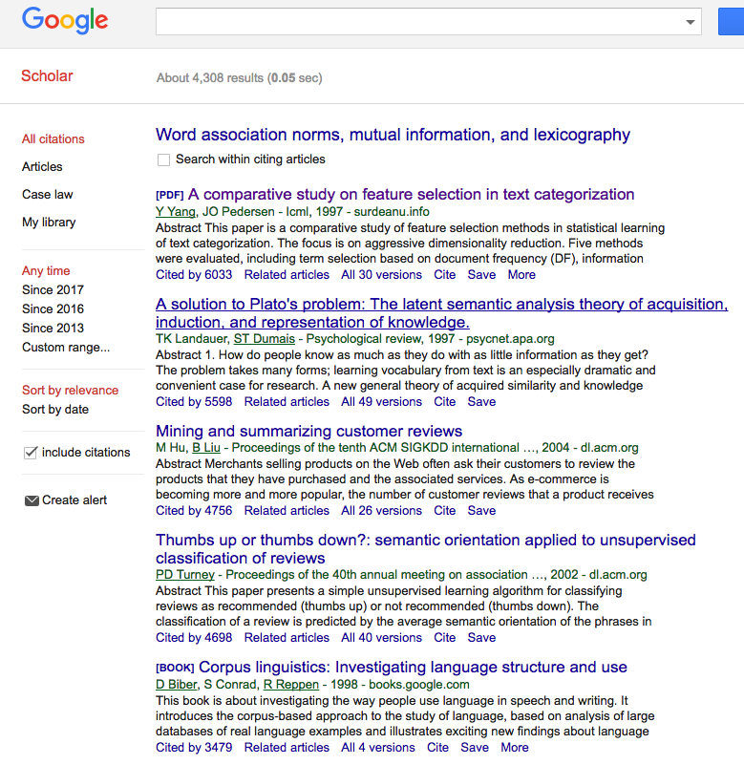
Using Google Scholar to find subsequent work to call out
Text Classification
LSA
Sentiment
Sentiment
Lexicography

Slide 29
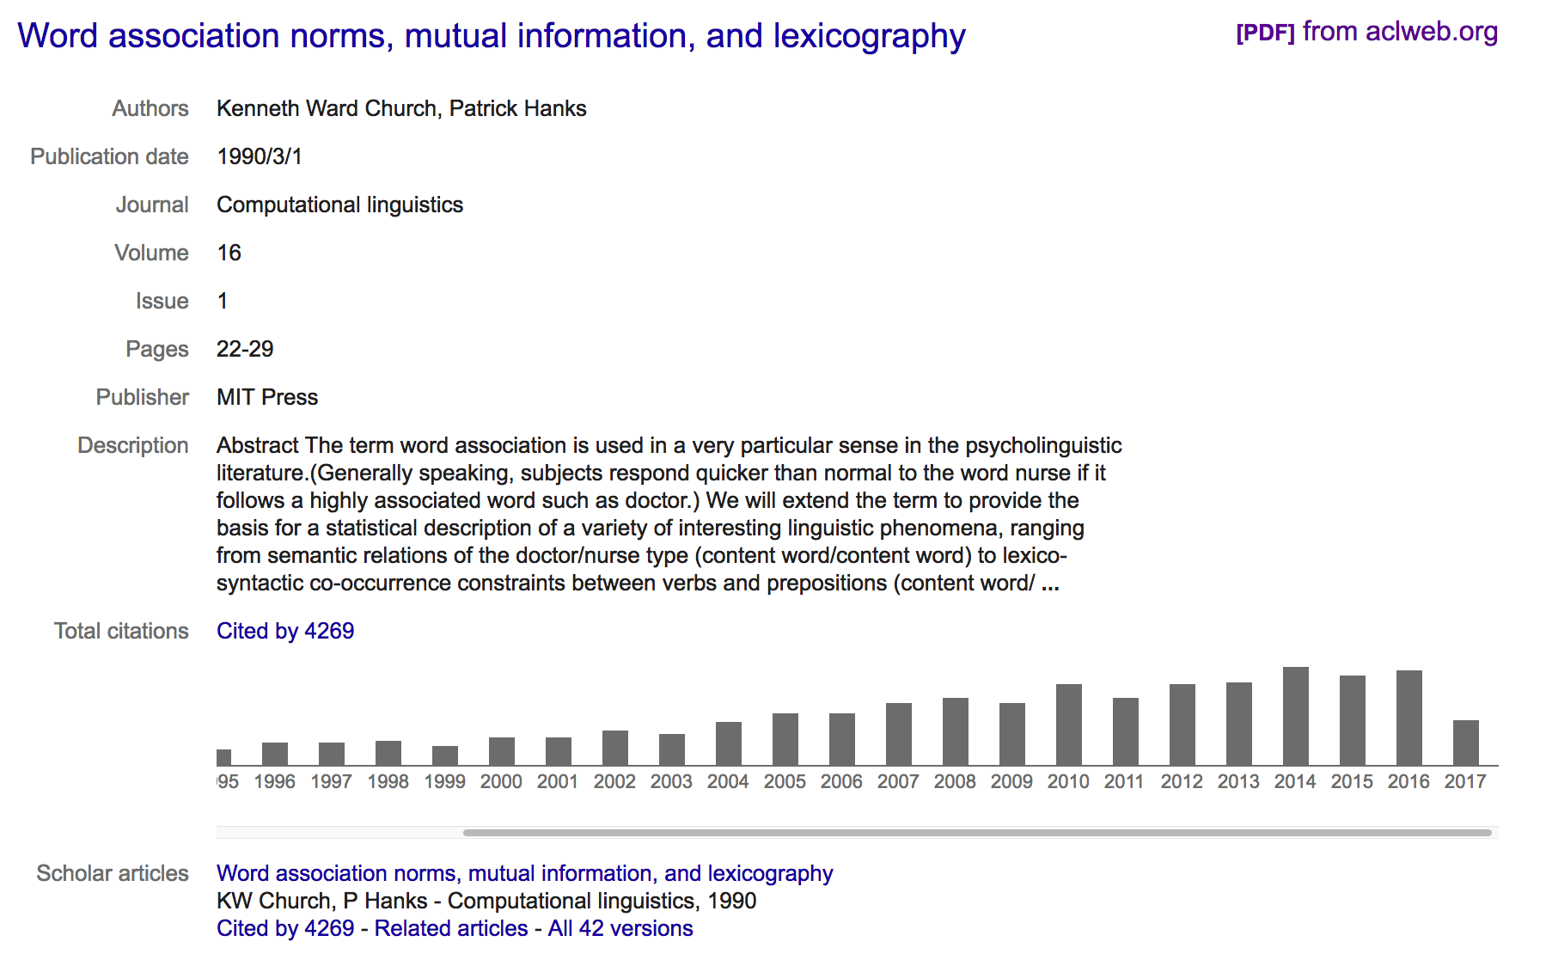
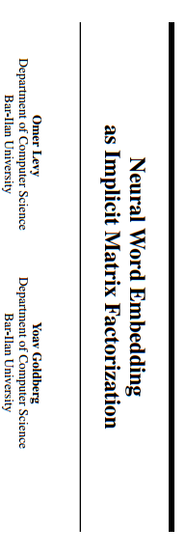
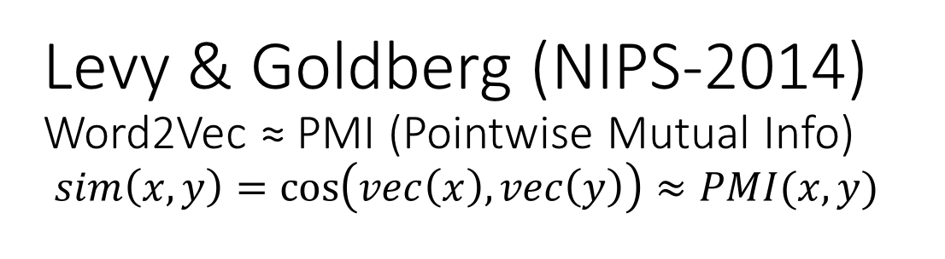
Levy & Goldberg (NIPS-2014) Word2Vec ≈ PMI (Pointwise Mutual Info) $sim\left(x,y\right)=\cos\left(vec\left(x\right), vec\left(y\right)\right)≈PMI(x,y)$
What happened in 2014?

Slide 30
Word2vec is popular (massively cited)
Word2vec is not first, last or best to discuss
Vector spaces, embeddings, analogies, similarity metrics, etc.
But word2vec is simple and accessible
Anyone can download the code and use it in their next paper.
Any many do (for better and for worse)
Available downloads
Pre-computed vectors (no training required)
Code for training your own vectors on your own corpora

Slide 31
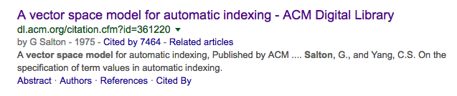
Salton’s Vector Space Model

Slide 32
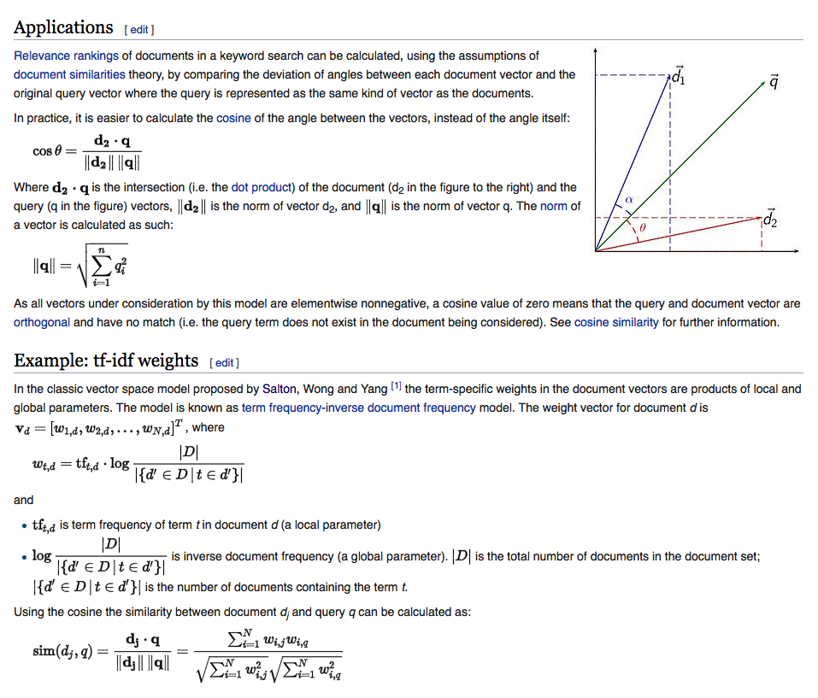
Embeddings: Similarity of docs/words ≈ cos (dot product)

Slide 33
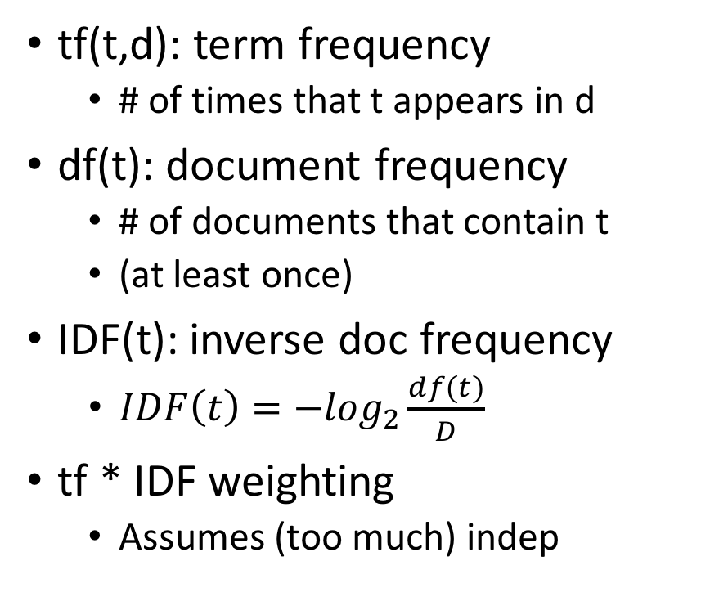
Information Retrieval (IR) notation Term Weighting: tf * IDF
t: term
d: document
D: # of documents in library
tf(t,d): term frequency
# of times that t appears in d
df(t): document frequency
# of documents that contain t
(at least once)
IDF(t): inverse doc frequency
$IDF\left(t\right)=−\log_{2}\frac{df(t)}{D}$
tf * IDF weighting
Assumes (too much) indep

Slide 35
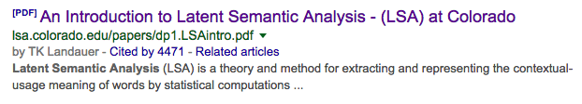
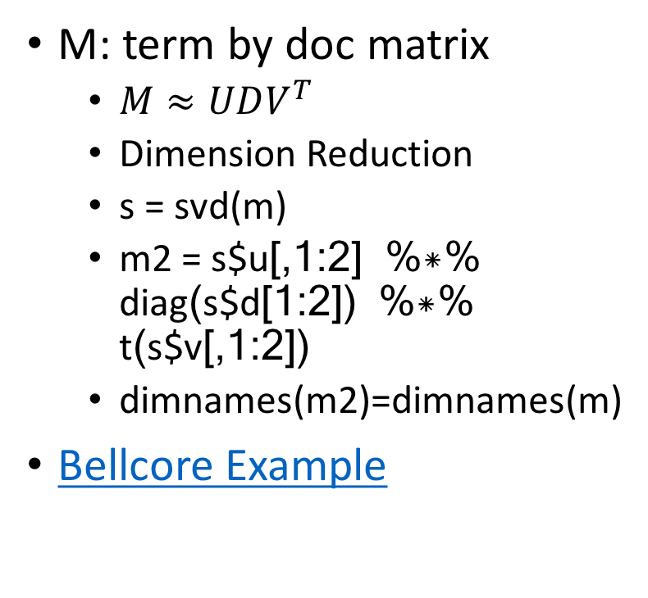
LSA/LSI: Latent Semantic Analysis/Indexing SVD: Singular Value Decomposition PCA: Principal Component Analysis
 | c1 | c2 | c3 | c4 | c5 | m1 | m2 | m3 | m4
human | 1 | 0 | 0 | 1 | 0 | 0 | 0 | 0 | 0
interface | 1 | 0 | 1 | 0 | 0 | 0 | 0 | 0 | 0
computer | 1 | 1 | 0 | 0 | 0 | 0 | 0 | 0 | 0
user | 0 | 1 | 1 | 0 | 1 | 0 | 0 | 0 | 0
system | 0 | 1 | 1 | 2 | 0 | 0 | 0 | 0 | 0
response | 0 | 1 | 0 | 0 | 1 | 0 | 0 | 0 | 0
time | 0 | 1 | 0 | 0 | 1 | 0 | 0 | 0 | 0
EPS | 0 | 0 | 1 | 1 | 0 | 0 | 0 | 0 | 0
survey | 0 | 1 | 0 | 0 | 0 | 0 | 0 | 0 | 1
trees | 0 | 0 | 0 | 0 | 0 | 1 | 1 | 1 | 0
graph | 0 | 0 | 0 | 0 | 0 | 0 | 1 | 1 | 1
minors | 0 | 0 | 0 | 0 | 0 | 0 | 0 | 1 | 1
M: term by doc matrix
$M≈UDV^{T}$
Dimension Reduction
s = svd(m)
m2 = s$u[,1:2] %*% diag(s$d[1:2]) %*% t(s$v[,1:2])
dimnames(m2)=dimnames(m)
Bellcore Example

Slide 36
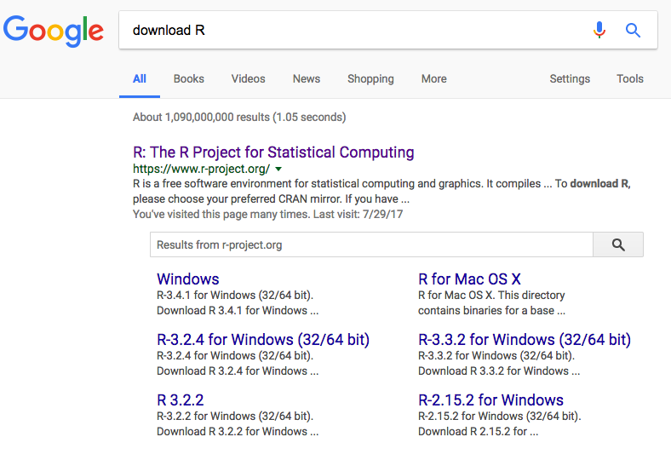

Slide 37
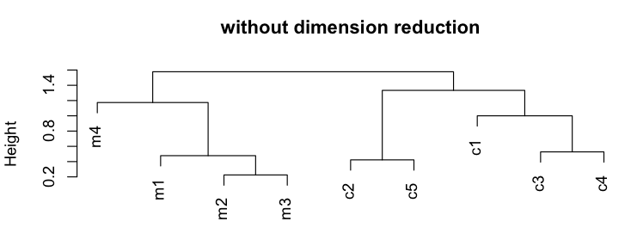
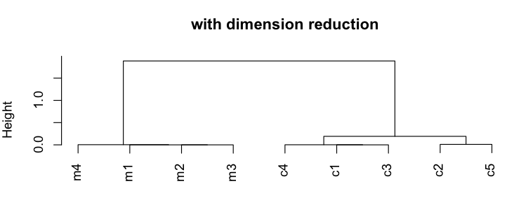
plot(hclust(as.dist(1-cor(m)))
 | c1 | c2 | c3 | c4 | c5 | m1 | m2 | m3 | m4
human | 1 | 0 | 0 | 1 | 0 | 0 | 0 | 0 | 0
interface | 1 | 0 | 1 | 0 | 0 | 0 | 0 | 0 | 0
computer | 1 | 1 | 0 | 0 | 0 | 0 | 0 | 0 | 0
user | 0 | 1 | 1 | 0 | 1 | 0 | 0 | 0 | 0
system | 0 | 1 | 1 | 2 | 0 | 0 | 0 | 0 | 0
response | 0 | 1 | 0 | 0 | 1 | 0 | 0 | 0 | 0
time | 0 | 1 | 0 | 0 | 1 | 0 | 0 | 0 | 0
EPS | 0 | 0 | 1 | 1 | 0 | 0 | 0 | 0 | 0
survey | 0 | 1 | 0 | 0 | 0 | 0 | 0 | 0 | 1
trees | 0 | 0 | 0 | 0 | 0 | 1 | 1 | 1 | 0
graph | 0 | 0 | 0 | 0 | 0 | 0 | 1 | 1 | 1
minors | 0 | 0 | 0 | 0 | 0 | 0 | 0 | 1 | 1

Slide 38
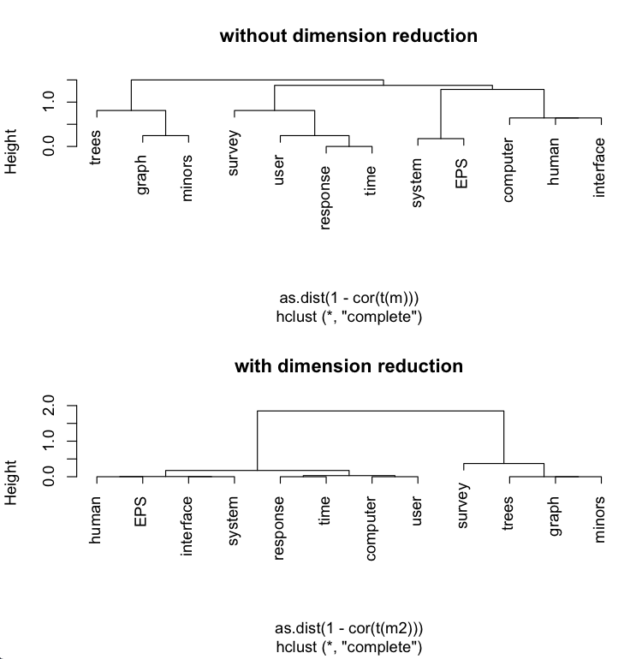
plot(hclust(as.dist(1-cor(t(m))))
 | c1 | c2 | c3 | c4 | c5 | m1 | m2 | m3 | m4
human | 1 | 0 | 0 | 1 | 0 | 0 | 0 | 0 | 0
interface | 1 | 0 | 1 | 0 | 0 | 0 | 0 | 0 | 0
computer | 1 | 1 | 0 | 0 | 0 | 0 | 0 | 0 | 0
user | 0 | 1 | 1 | 0 | 1 | 0 | 0 | 0 | 0
system | 0 | 1 | 1 | 2 | 0 | 0 | 0 | 0 | 0
response | 0 | 1 | 0 | 0 | 1 | 0 | 0 | 0 | 0
time | 0 | 1 | 0 | 0 | 1 | 0 | 0 | 0 | 0
EPS | 0 | 0 | 1 | 1 | 0 | 0 | 0 | 0 | 0
survey | 0 | 1 | 0 | 0 | 0 | 0 | 0 | 0 | 1
trees | 0 | 0 | 0 | 0 | 0 | 1 | 1 | 1 | 0
graph | 0 | 0 | 0 | 0 | 0 | 0 | 1 | 1 | 1
minors | 0 | 0 | 0 | 0 | 0 | 0 | 0 | 1 | 1

Slide 39
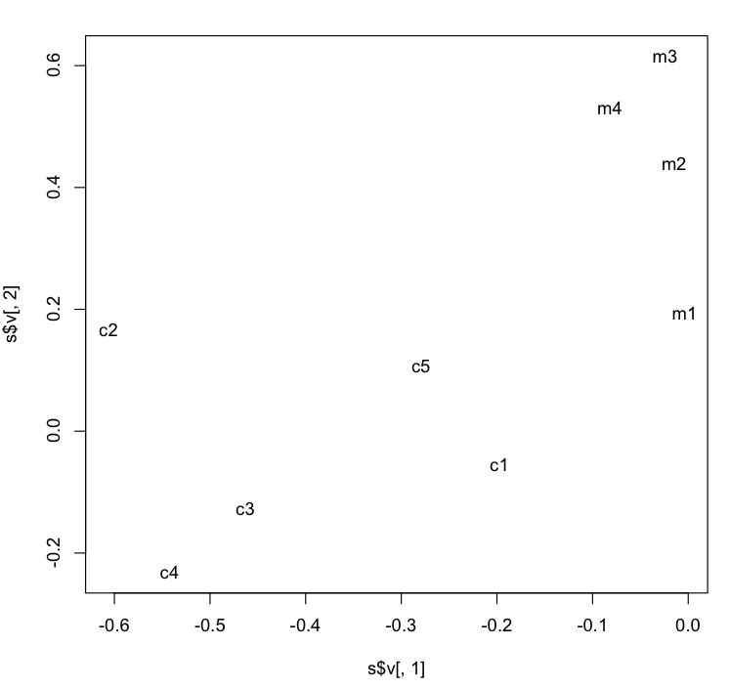
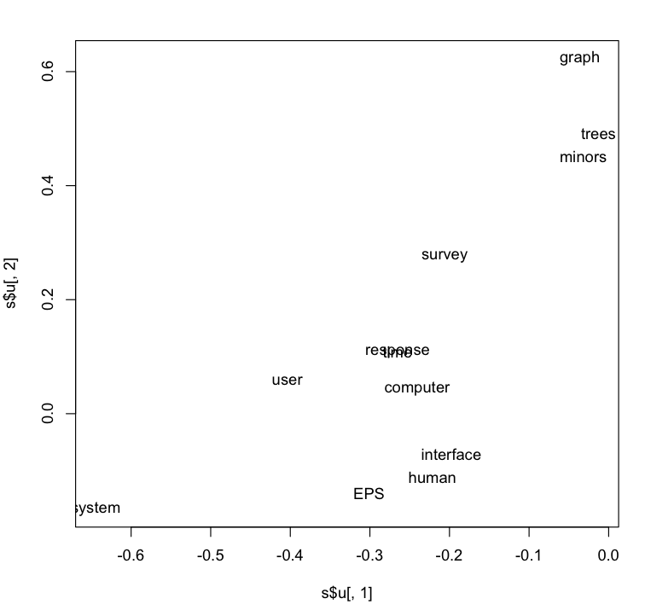
LSA maps terms & docs into internal dimensions

Slide 40
Word2vec is popular (massively cited)
Word2vec is not first, last or best to discuss
Vector spaces, embeddings, analogies, similarity metrics, etc.
But word2vec is simple and accessible
Anyone can download the code and use it in their next paper.
Any many do (for better and for worse)
Available downloads
Pre-computed vectors (no training required)
Code for training your own vectors on your own corpora

Slide 41
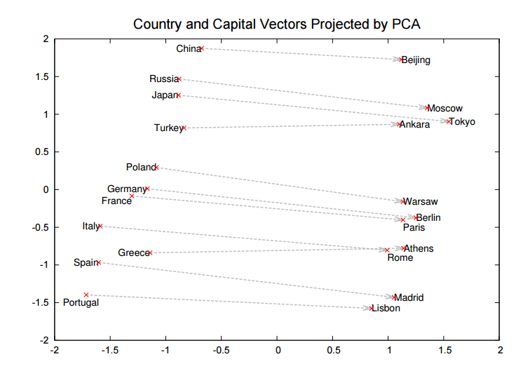
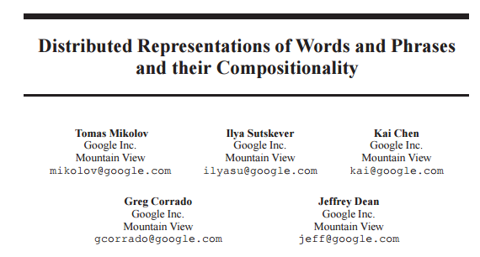
Word2Vec: $sim\left(x,y\right)=\cos\left(vec\left(x\right), vec\left(y\right)\right)≈PMI(x,y)$ https://code.google.com/archive/p/word2vec/
Linguistic generalizations
Word associations (distance in plot)
Features (red line)
Countries & Capitals
Analogies:
Man : Woman :: King : x
x → queen
Athens : Greece :: Bangkok: x
x → Thailand
Vector Space (Salton)
Addition & subtraction
Clustering, PCA
Convenient for Neural Networks

Slide 42
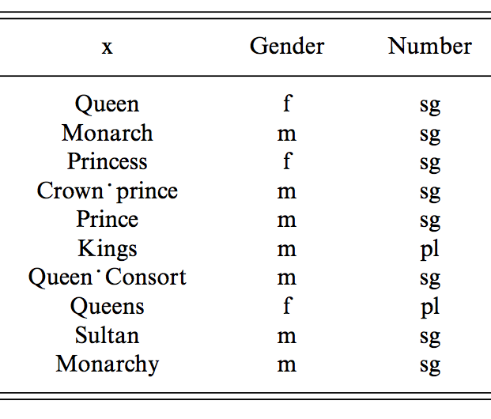
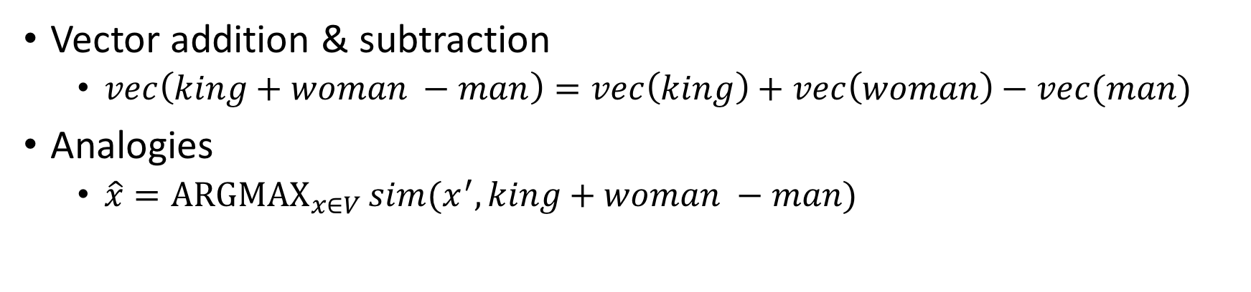
man : woman :: king : x
Vector addition & subtraction
$vec\left(king+woman −man\right)=vec\left(king\right)+vec\left(woman\right)−vec(man)$
Analogies
$\hat{x}=\underset{x∈V}{ARGMAX}{sim(x^{′}, king+woman −man)}$

Slide 43
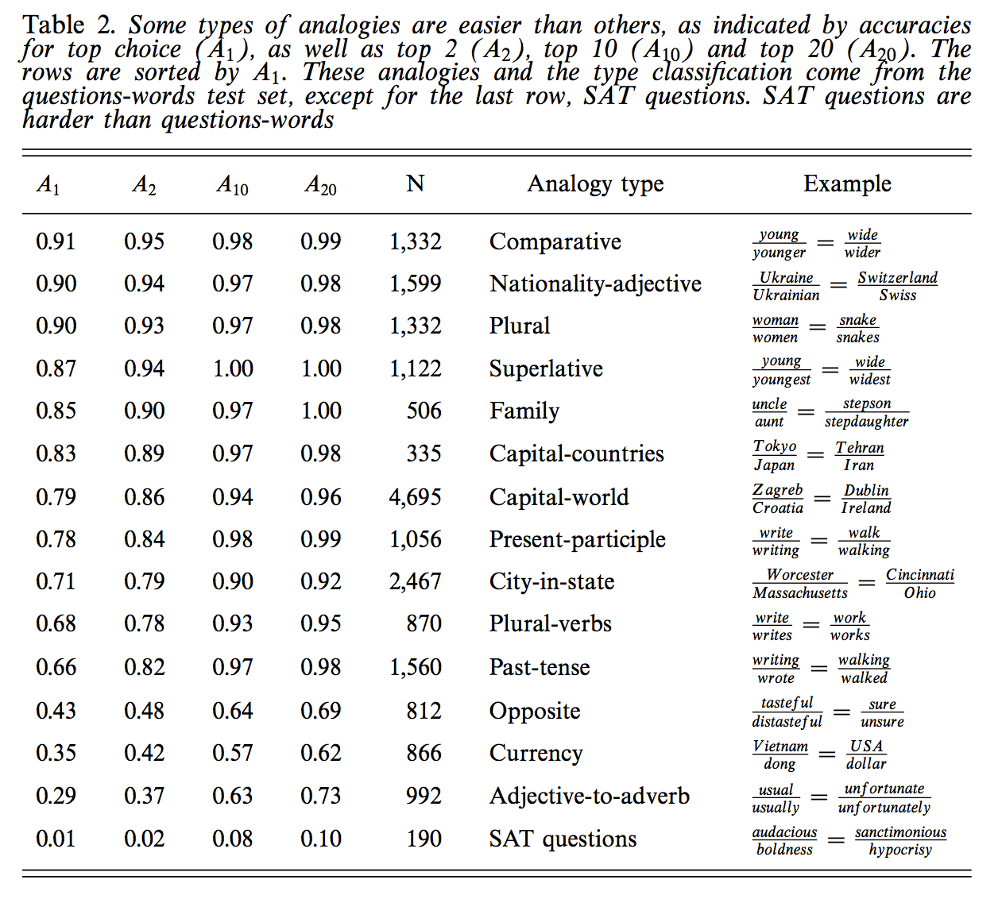
Some analogies are easier than others
Tweets
RT @tallinzen: sure, king:queen etc, but did you know word2vec gets real SAT analogies right just 1% of the time?
15 copies of this tweet
Some by NLP experts
Resources Debate
WordNet &
British National Corpora

Slide 44

Levy & Goldberg (NIPS-2014) Word2Vec ≈ PMI (Pointwise Mutual Info)
Levy & Goldberg (NIPS-2014) is a theoretical arg
Plots → correlations are large, but far from perfect
Materials:
N = 22 words (11 cities + 11 countries)
N (N-1)/2 = 231 pairs of words (points)
type in {city, country}
Color:
Green → type match
Red → type mismatch

Slide 45

GloVe: https://nlp.stanford.edu/projects/glove/
Alternative to Word2vec:
Similar performance
Both Word2vec & GloVe ≈ PMI
More interpretable:
Neural net → SGD minimization of a sensible loss
More generous license
Both methods output embedding $M$
$M: V$ by $K$ matrix where $M×M^{T}≈P$
$V$: size of vocabulary
$K$: # of internal dimensions
$P$: $V$ by $V$matrix of PMI values
Space: GloVe materializes a $V^{2}$matrix while computing $M$ (unlike Word2vec)

Slide 46

Glass is half-full/empty Word2vec is similar to PMI (but different)

Slide 47
IMHO: Word2vec & GloVe >> PMI
Glass is half full
Levy & Goldberg are correct in pointing out similarities
But half empty
Word2vec & GloVe do better in practice
Because of “tricks” for small counts, etc.
Code is not well understood
Even though there isn’t much there
702 lines in word2vec.c; 446 in glove.c
Dimension Reduction
Matrix completion (?!?)
Obvious suggestion, SVD on PMIs
Disappointing in practice
May not want to model PMI too well

Slide 48


Estimating PMI (and Contingency Tables) Li & Church, Computational Linguistics (2007)
Compute Sample Contingency Table
MLE Inference:
What is the most likely original table
Given sample and margins?
Evaluation
http://stat.rutgers.edu/home/pingli/

Slide 49


Prior Art: Removing (Near) Duplicate Web Pages

Slide 50

Computing Contingency Tables (Brute Force)
5
7
12
7
17
Three constraints
Library: D = a + b + c + d = 36
Margins
f₁ = |P₁| = a + b = 12
f₂ = |P₂| = a + c = 12
a = |P₁ & P₂| = |{4,15, 19, 24, 28}| = 5
b = f₁ – a = 12 – 5 = 7
c = f₂ – a = 12 – 5 = 7
d = D – a – b – c = 36 – 5 – 7 – 7 = 17
12
36
crux
P₁ | 3 | 4 | 7 | 9 | 10 | 15 | 18 | 19 | 24 | 25 | 28 | 33
P₂ | 2 | 4 | 5 | 8 | 15 | 19 | 21 | 24 | 27 | 28 | 31 | 35

Slide 51
Computing Sample Contingency Table (Using Sketches, An Approximation: Yellow)
Key: throw out red {19, 21}
D_{s} = min(max(sketch(w₁)), max(sketch(w₂))) = 18
Can’t tell that 19 is in intersection and 21 is not
Without looking outside the sketch
Ω_{s} = {1, 2,…,D_{s}}
a_{s} = sketch(w₁) & sketch(w₂) & Ω_{s} = |{4,15}| = 2
b_{s} = |sketch(w₁) & Ω_{s}| – a_{s} = 7 – 2 = 5
c_{s} = |sketch(w₂) & Ω_{s}| – a_{s} = 5 – 2 = 3
d_{s} = Ds – a_{s} – b_{s} – c_{s} = 18 – 2 – 5 – 3 = 8
D_{s} = Sample Size
crux
Sketch = Front of Postings
P₁ | 3 | 4 | 7 | 9 | 10 | 15 | 18 | 19 | 24 | 25 | 28 | 33
P₂ | 2 | 4 | 5 | 8 | 15 | 19 | 21 | 24 | 27 | 28 | 31 | 35
Doc IDs need to be random

Slide 52
MLE Inference: What is the most likely table Given sample and margins?
When we know the margins,
We ought to use them
D_{s}/D = Sampling Rate
Consider all possible contingency tables:
a, b, c & d
Select the table that maximizes the probability of observations
a_{s}, b_{s}, c_{s} & d_{s}

Slide 53

Empirical Evaluation MLE >> MF >> Independence
IND (assume independence):
too much error
MF (Margin-Free)
Target: minimize effort & error
D_{s}/D = Sampling Rate (effort)

Slide 54


Non-Empirical Evaluation (Closed Form)
Non-Empirical Evaluation:
MLE has smaller variance than Margin Free (MF) baseline
Confirms Empirical Evaluation:
MLE has less error than MF
When we have margins, we should use them
Improves accuracy as well as consistency

Slide 55
Sketches vs. Word2Vec (as estimates of PMI)
It is said that word2vec is fast
But sketches are also fast
and closer to PMI
But is closer to PMI better?

Slide 56
Interestingness Metrics: Deviations from Independence
Poisson (and other independence assumptions)
Not bad for meaningless random strings
Deviations from Poisson are clues for hidden variables
Meaning, content, genre, topic, author, etc.
Analogous to mutual information (Hanks)
Pr(doctor…nurse) >> Pr(doctor) Pr(nurse)

Slide 57


Slide 58


Slide 59


Slide 60


Adaptation: Three Approaches
Cache-based adaptation
Parametric Models
Poisson, Two Poisson, Mixtures (neg binomial)
Non-parametric
Pr(+adapt₁) ≡ Pr(test|hist)
Pr(+adapt₂) ≡ Pr(k≥2|k ≥1)

Slide 61
Positive & Negative Adaptation
Adaptation:
How do probabilities change as we read a doc?
Intuition: If a word w has been seen recently
+adapt: prob of w (and its friends) goes way up
−adapt: prob of many other words goes down a little
Pr(+adapt) >> Pr(prior) > Pr(−adapt)

Slide 62
Adaptation: Method 1
Split each document into two equal pieces:
Hist: 1st half of doc
Test: 2nd half of doc
Task:
Given hist
Predict test
Compute contingency table for each word
Documents containing hostages in 1990 AP News
 | test
hist | 638 | 505
 | 557 | 76,787

Slide 63
Adaptation: Method 1
 | test
hist | a | b
 | c | d
Notation
D = a+b+c+d (library)
df = a+b+c (doc freq)
Prior:
+adapt
−adapt
Documents containing hostages
Pr(+adapt) >> Pr(prior) > Pr(−adapt)
+adapt | prior | −adapt | source
0.56 | 0.014 | 0.0069 | AP 1987
0.56 | 0.015 | 0.0072 | AP 1990
0.59 | 0.013 | 0.0057 | AP 1991
0.39 | 0.004 | 0.0030 | AP 1993

Slide 64

Adaptation: Hist >> Near >> Prior
Magnitude is huge
Shape: Given/new
1st mention: marked
Surprising (low prob)
Depends on freq
2nd: unmarked
Less surprising
Independent of freq
Priming:
“a little bit” marked

Slide 65
Adaptation: Method 2
Pr(+adapt₂)
df_{k}(w) ≡ number of docs that
mention word w
at least k times
df₁(w) ≡ standard def of document freq (df)

Slide 66
Pr(+adapt₁) ≈ Pr(+adapt₂) Within factors of 2-3 (as opposed to 10-1000)
3rd mention
Priming

Slide 67
Adaptation is Lexical
Lexical: adaptation is
Stronger for good keywords (Kennedy)
Than random strings, function words (except), etc.
Content ≠ low frequency
+adapt | prior | −adapt | source | word
0.27 | 0.012 | 0.0091 | AP90 | Kennedy
0.40 | 0.015 | 0.0084 | AP91 | Kennedy
0.32 | 0.014 | 0.0094 | AP93 | Kennedy
0.049 | 0.016 | 0.016 | AP90 | except
0.048 | 0.014 | 0.014 | AP91 | except
0.048 | 0.012 | 0.012 | AP93 | except

Slide 68
Adaptation Conclusions
Large magnitude (p/2 >> p²); big quantity discounts
Distinctive shape
1st mention depends on freq
2nd does not
Priming: between 1st mention and 2nd
Lexical:
Independence assumptions aren’t bad for meaningless random strings, function words, common first names, etc.
More adaptation for content words (good keywords, OOV)

Slide 69


Conclusions / Plan
Summarize main points of paper
Call out
some highlights of subsequent literature
Word2vec ≈ PMI (with factoring)
Word2vec ≈ LSA / SVD (similar factoring)
Are there better ways to approximate PMI? Sketches?
suggestions for future work
If the matrix that we are factoring isn't positive definite,
then the optimization might be looking for a solution that may not exist.
It might be useful to generalize the optimization to consider solutions where the left eigenvector need not be the same as the right eigenvector, or where the solution can make use of imaginary numbers.
It is common for embeddings to use K=300 dimensions,
but most words don't appear K times in the corpus.
It is hard to justify K parameters for a word that doesn't appear K times.

Slide 70
backup

Slide 71


s=svd(m) m2 = s$u[,1:2] %*% diag(s$d[1:2]) %*% t(s$v[,1:2]) dimnames(m2) = dimnames(m)
heatmap(m)
heatmap(m2)

